Slide 1


Analysis on Oakland Crime Statistics
Jiarong Ye, Han Shao, Yichi Qian
DS 220

Slide 2
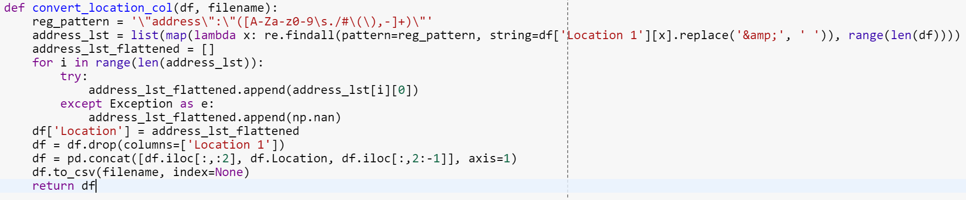
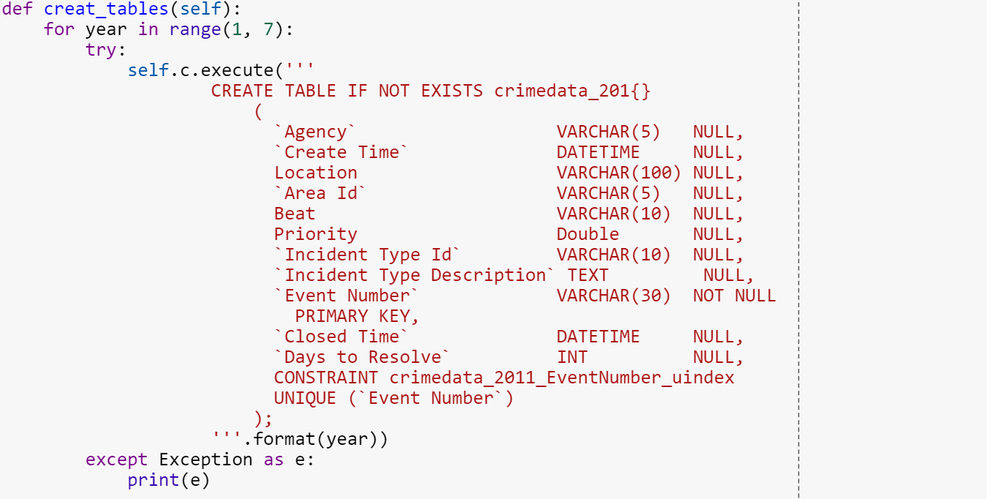
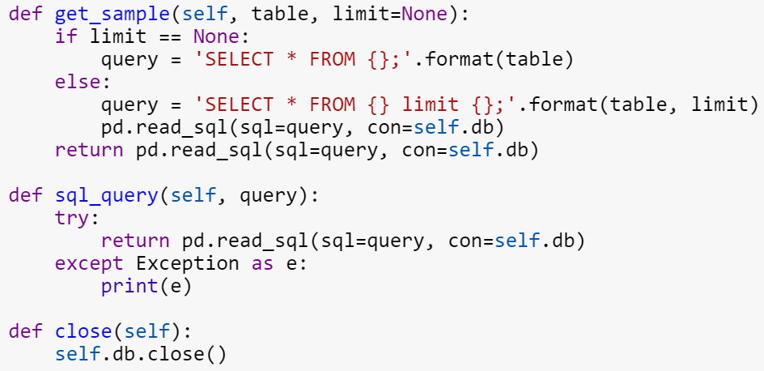
How we process the raw data
Formatting the address
Load data into Mysql
Load data into Mysql(Cont.)

Slide 3
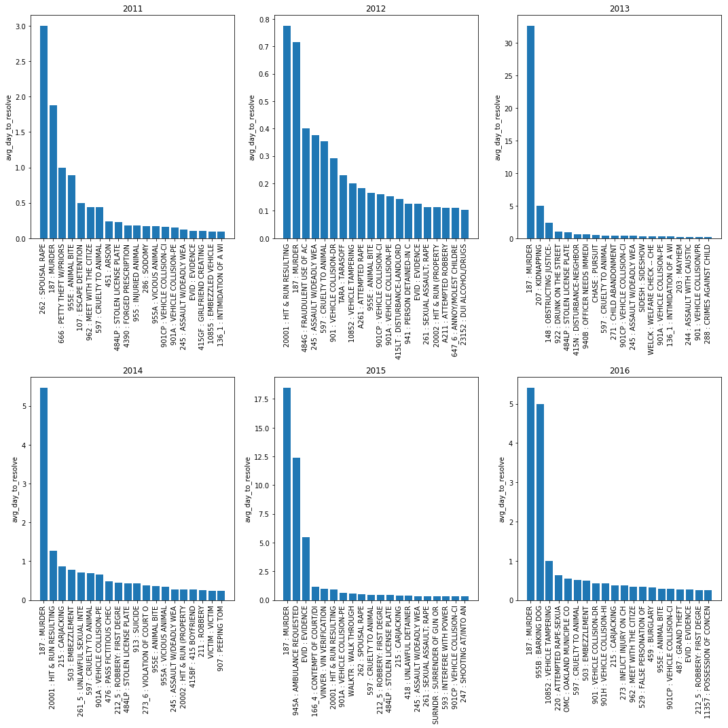
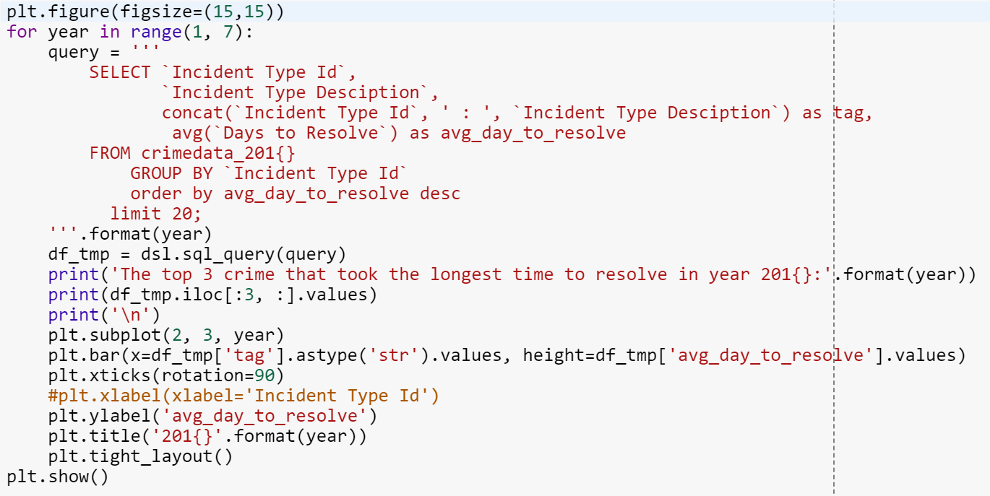
Average Days Spent on Solving Different Incident Types of for Each Year
Sample code of the plotting

Slide 4
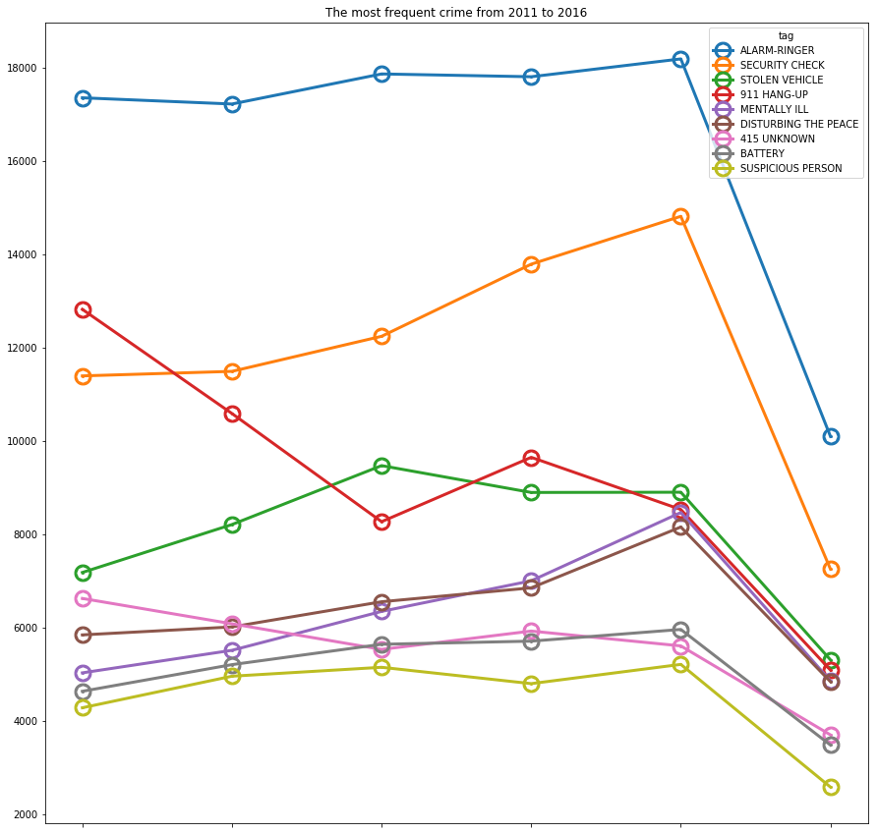
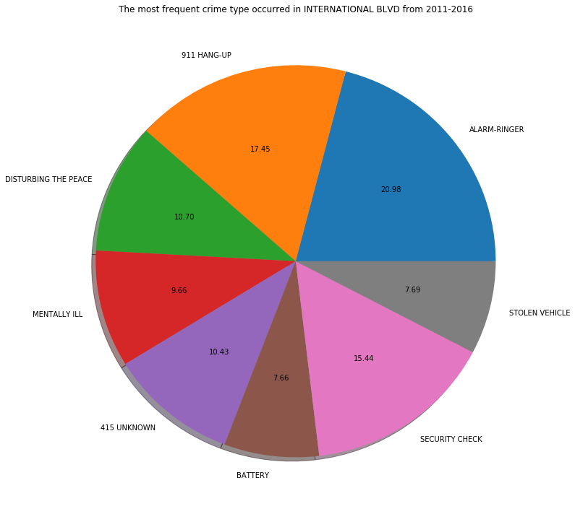
Other topics we covered…

Slide 5
Conclusion
From 2011, until 2016, the incident type that cost most days to investigate was Murder;
Overall, International Blvd is the area where most incidents were reported;
Among all incidents, Alarm Ringer is the most frequently reported type in Oakland as well as the International Blvd.

